Slide 1



By: August DeWinkler, Genesi Gonzalez, Nicholas Gamarra, David Gibson and Nicholas Angiolilli

Slide 2
Sync-Care mobile App allows interdisciplinary healthcare professionals to update the care plan of the patient while allowing the caregiver to participate in the process.
Our mobile application is intended to assist caregivers to collaborate with the care of their loved ones with Parkinson's Disease. This app is not intended to care for the patient, but to organize the caregiver's daily tasks, including medication intake and monitor nutritional and mobility progress.
The name of the project is called "Sync Care". This mobile app aims to organize and sync patient updated medical information, care plan and progress with their providers, caregivers and the entire interdisciplinary team.
Parkinson's is a debilitating disease that has less ability to regulate bodily movements and emotions. The goal is to treat the symptoms and maintain a high quality of life as possible. This app is intended to organize medication intake, nutritional intake and daily mobility in order to maintain an optimal quality of life. It can track progress and illustrate trends and patterns that will assist the patient and caregiver to manage the disease appropriately and inform the provider as well.

Slide 3
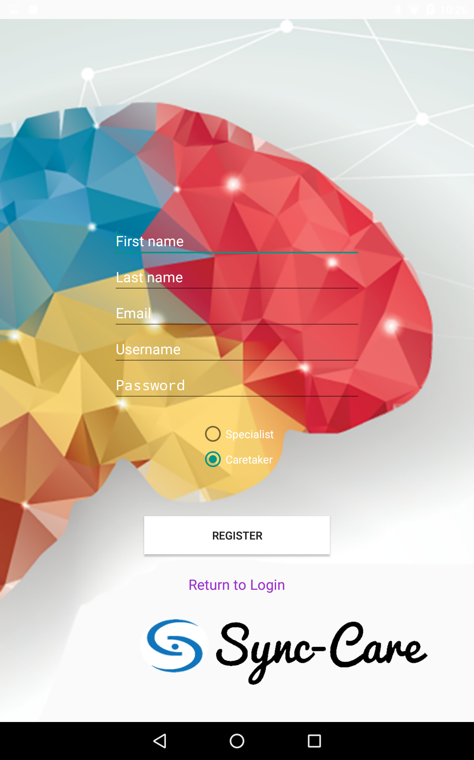
Sign Up Page
Here is our sign up page where the information needed is a first and last name, email for verification, and a username and password. You also have to select whether you are the primary caregiver of a patient(s) or a Medical Specialist

Slide 4
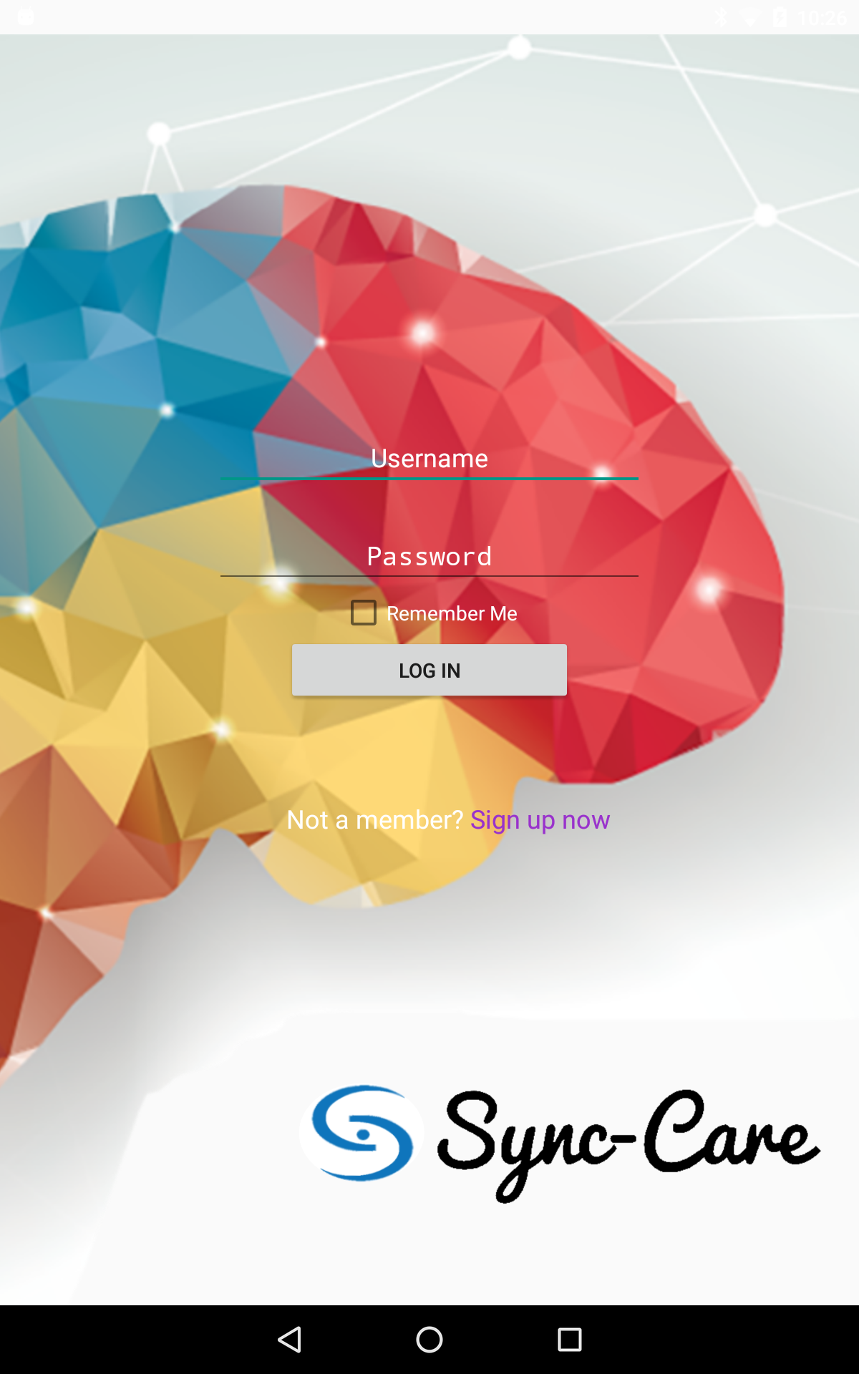
Log In Page
Encrypted passwords
Ability to store login credentials to skip log in page

Slide 5
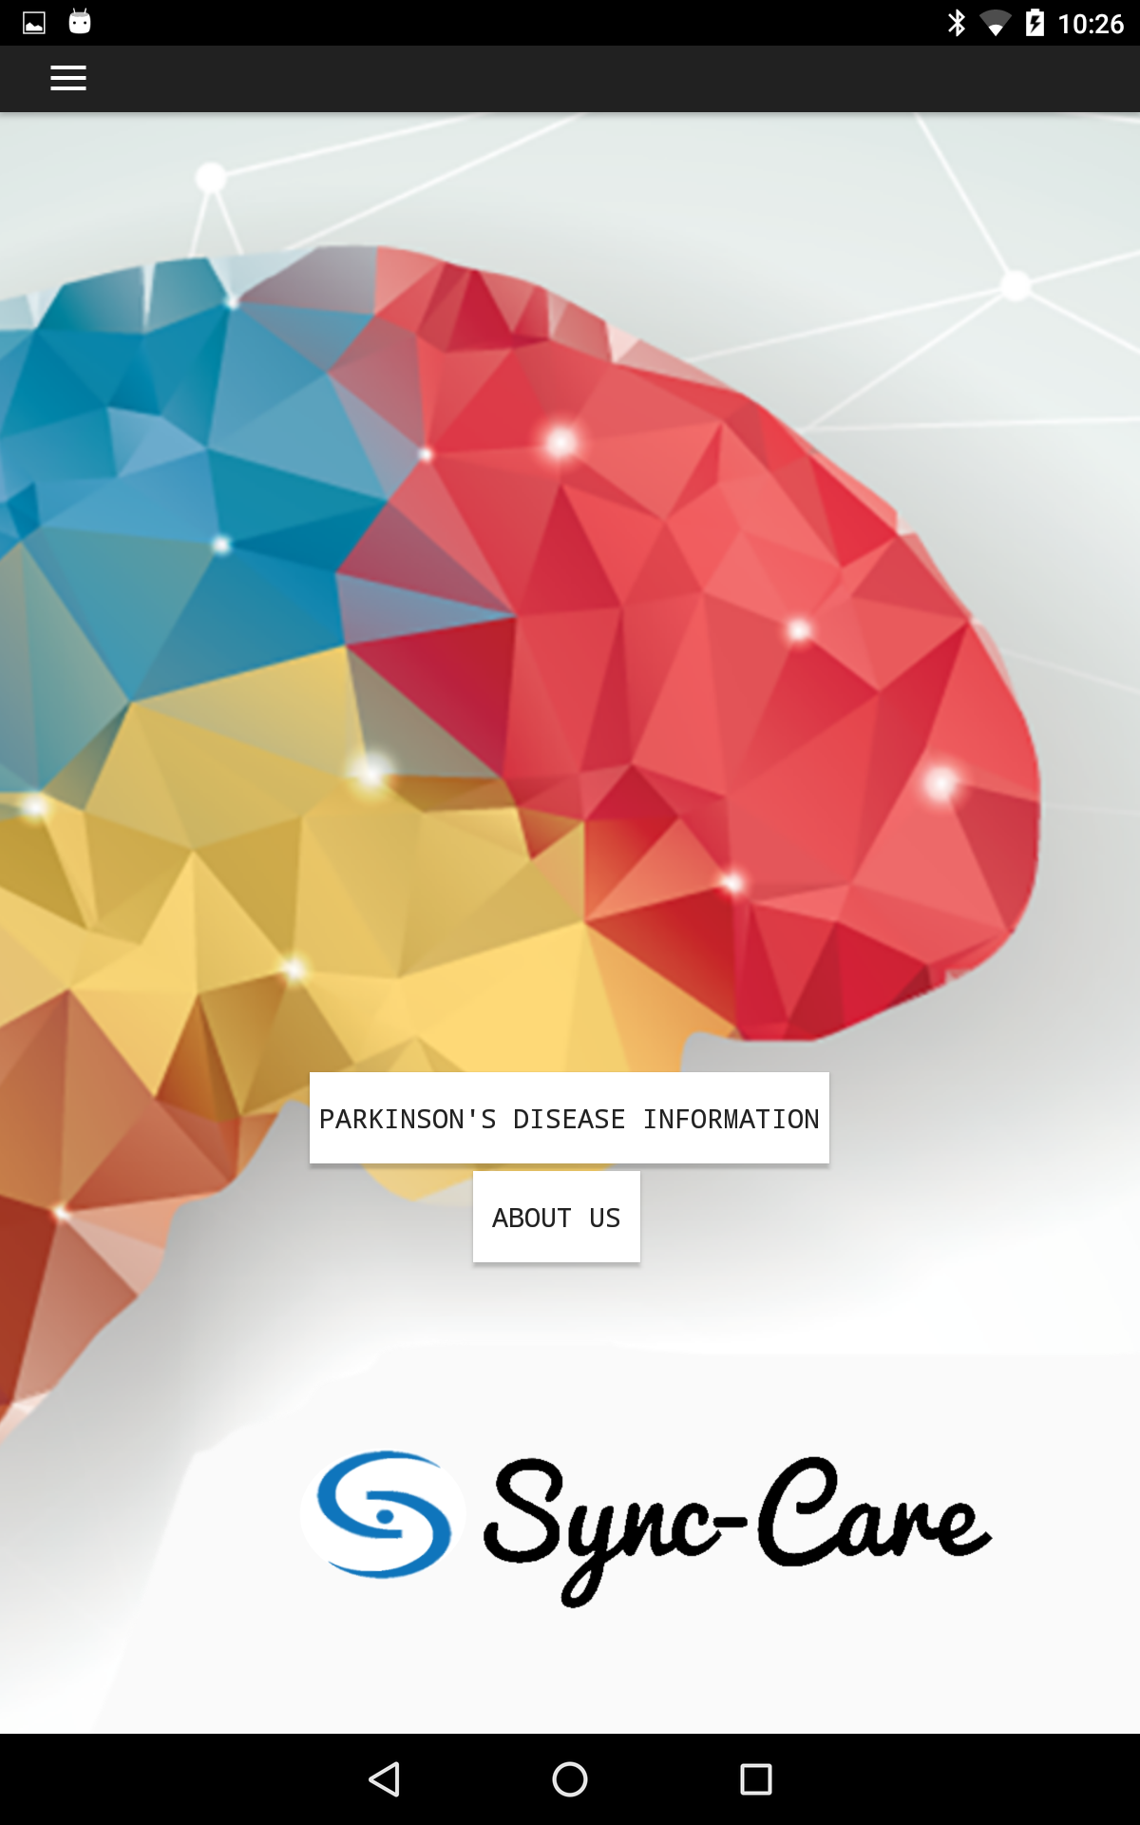
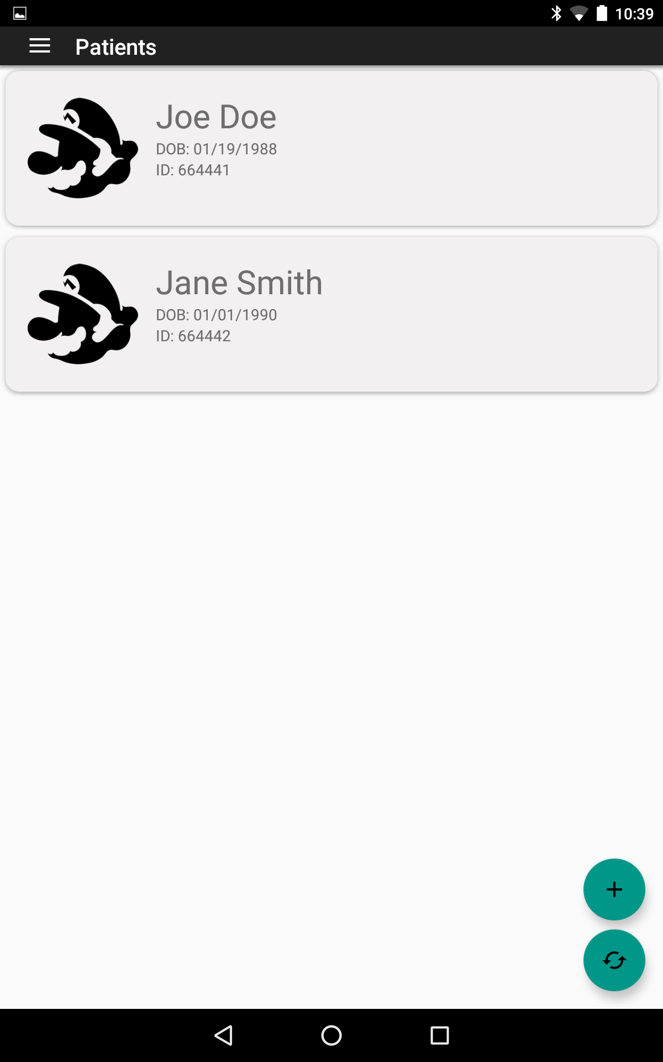
Caregiver Home Page
specialist Home Page
Specialist home page is
presented with a list of patients
the specialist is linked to.
Navigation Drawer
Information for the caregiver
to be informed about Parkinson’s disease
Pop-up that describes
what our app is about

Slide 6
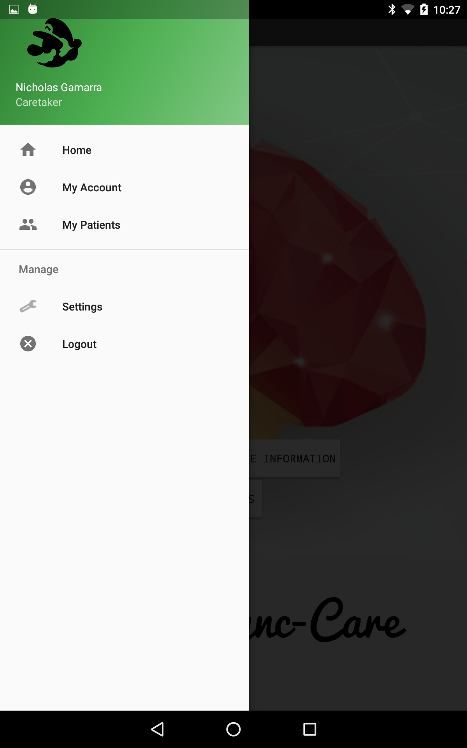
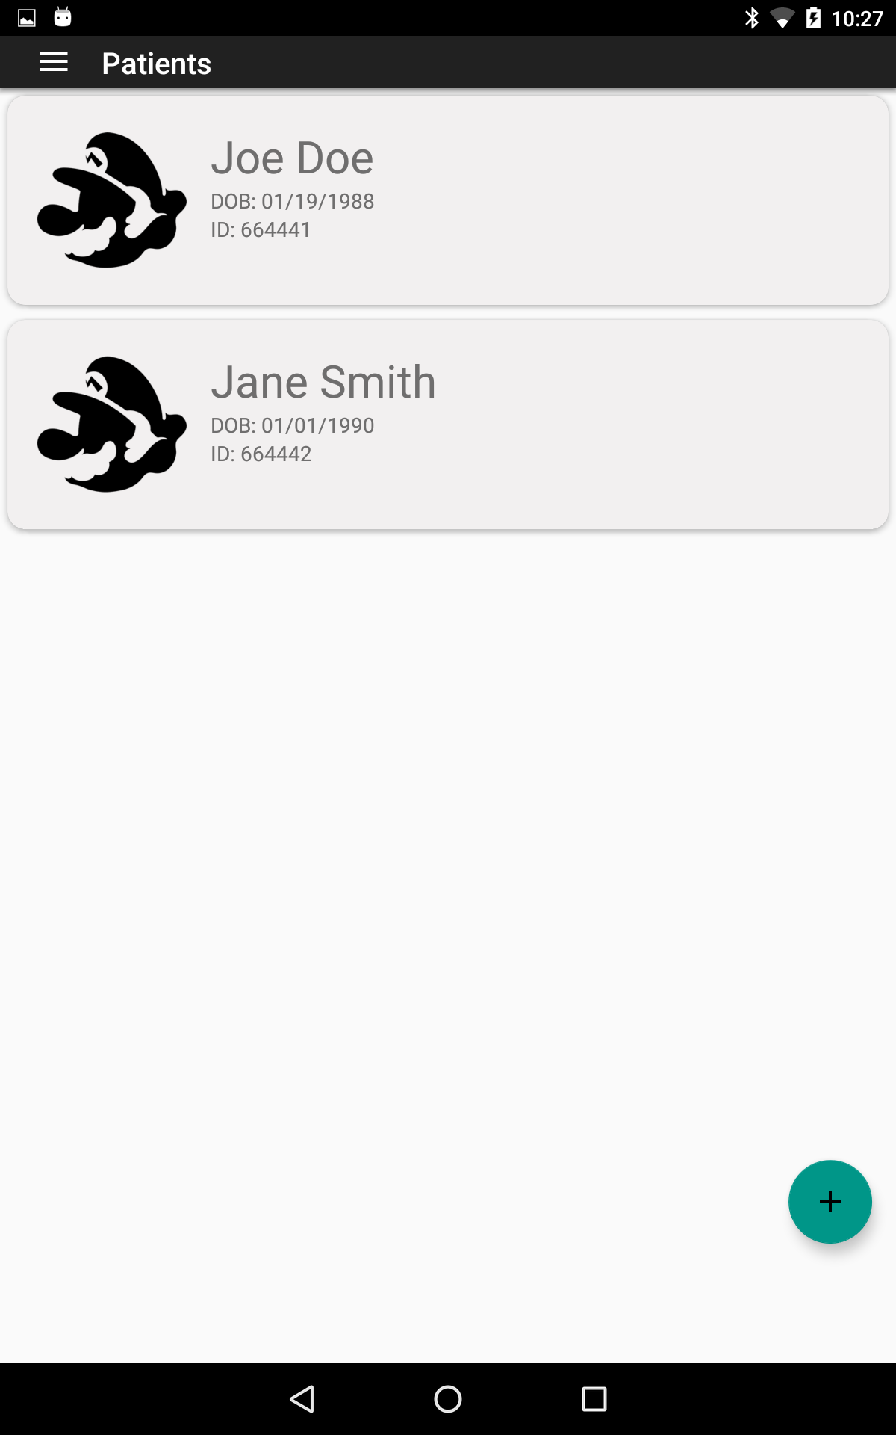
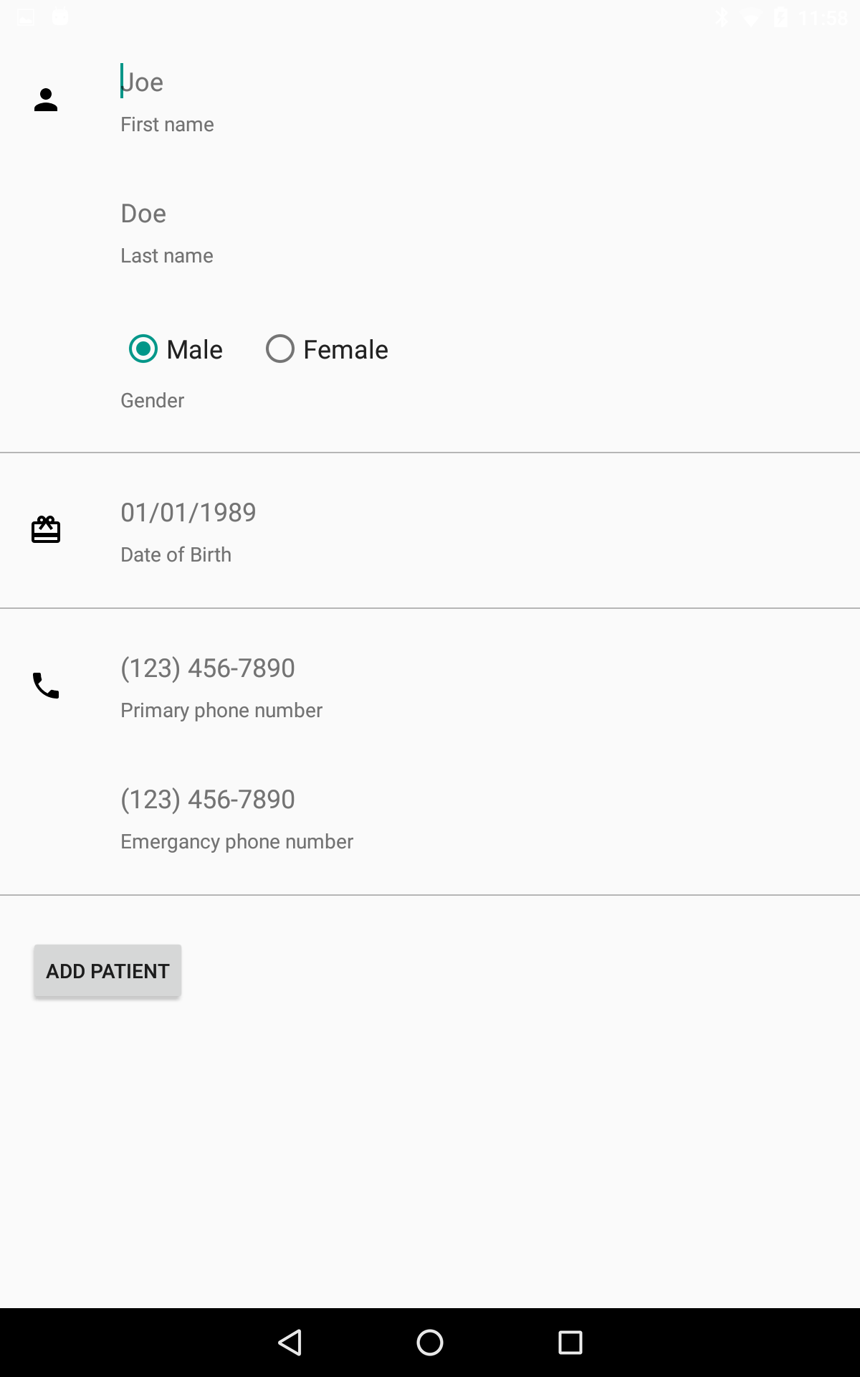
Adding Patients for caregiver
Once a patient is added you’ll see a list of the patients
The Mario logo will be replaced with an image the user can upload

Slide 7
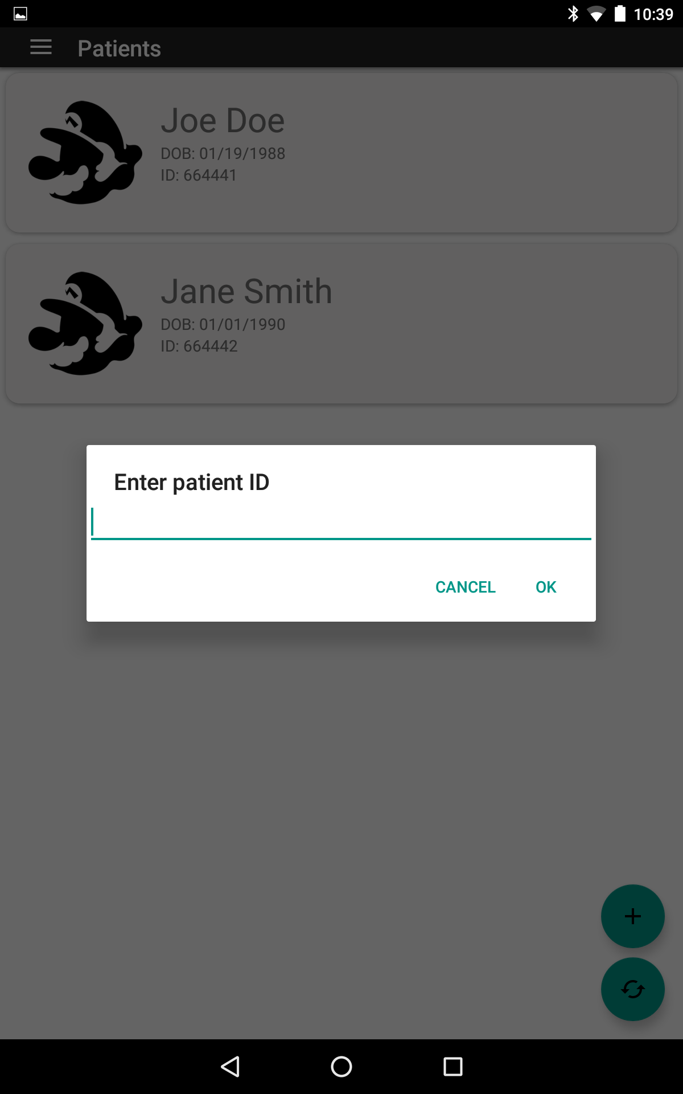
Adding Patients for Specialist
A specialist can sync with a patient by selecting the add button and entering the patients id that is given once a caregiver creates one. It’ll then give a notification to the user that they need to wait for confirmation from the caregiver before the patient is added.
Once they are added they will be represented as list as shown.
In order to check for confirmations the user just needs to hit the refresh icon

Slide 8
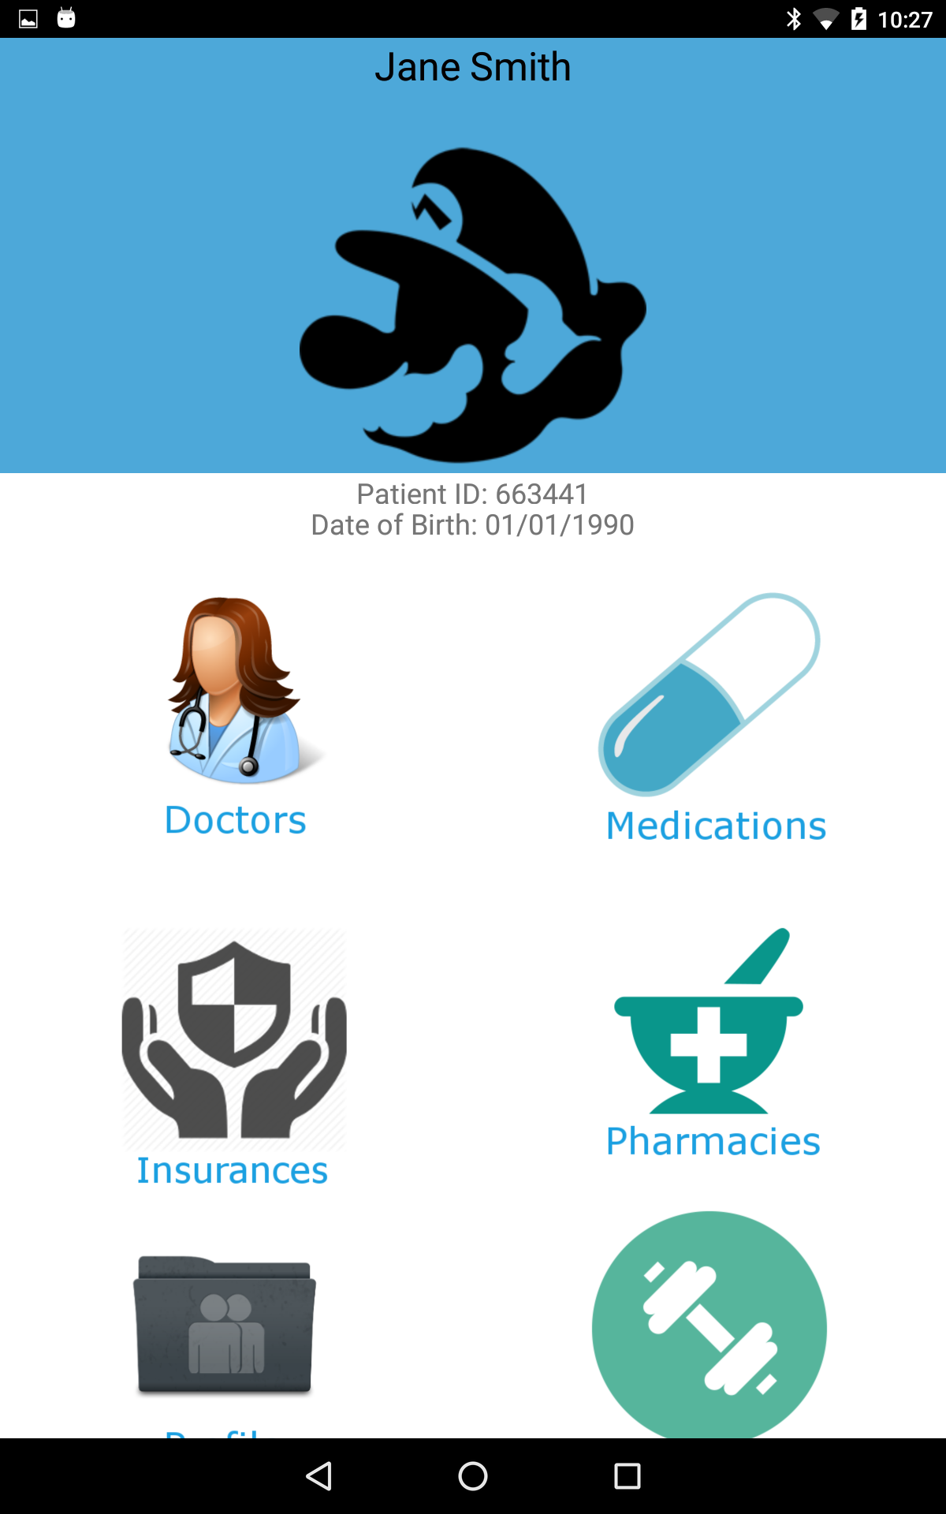
Patient Home Screen
Both accounts are presented with the same patient screen with the difference being that there will be restrictions on adding and editing on certain categories based on if you’re the caregiver or specialist.

Slide 9
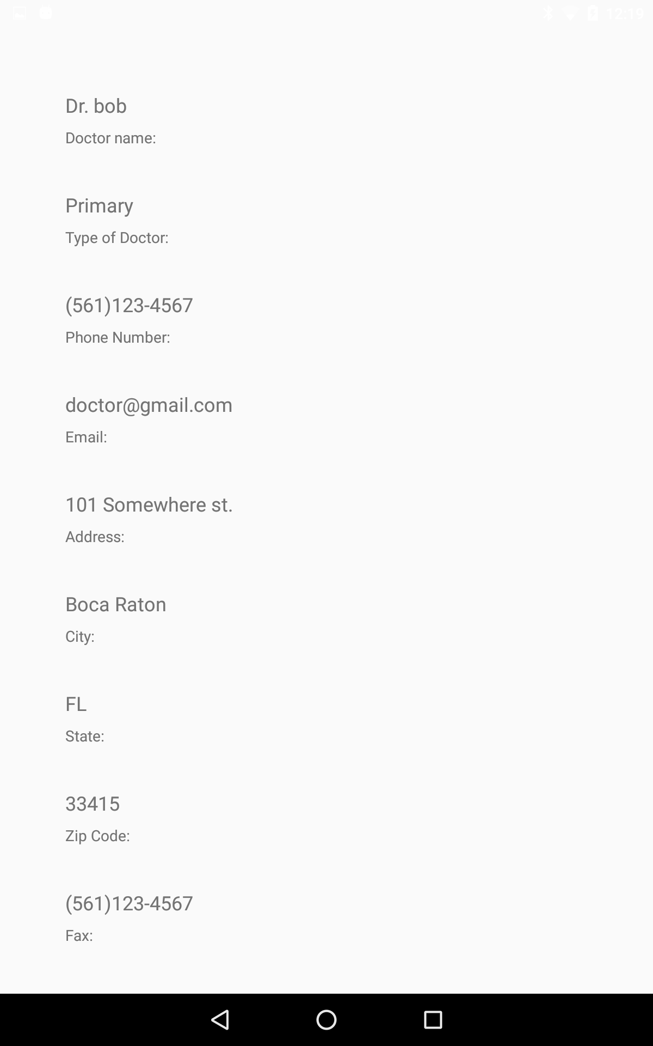
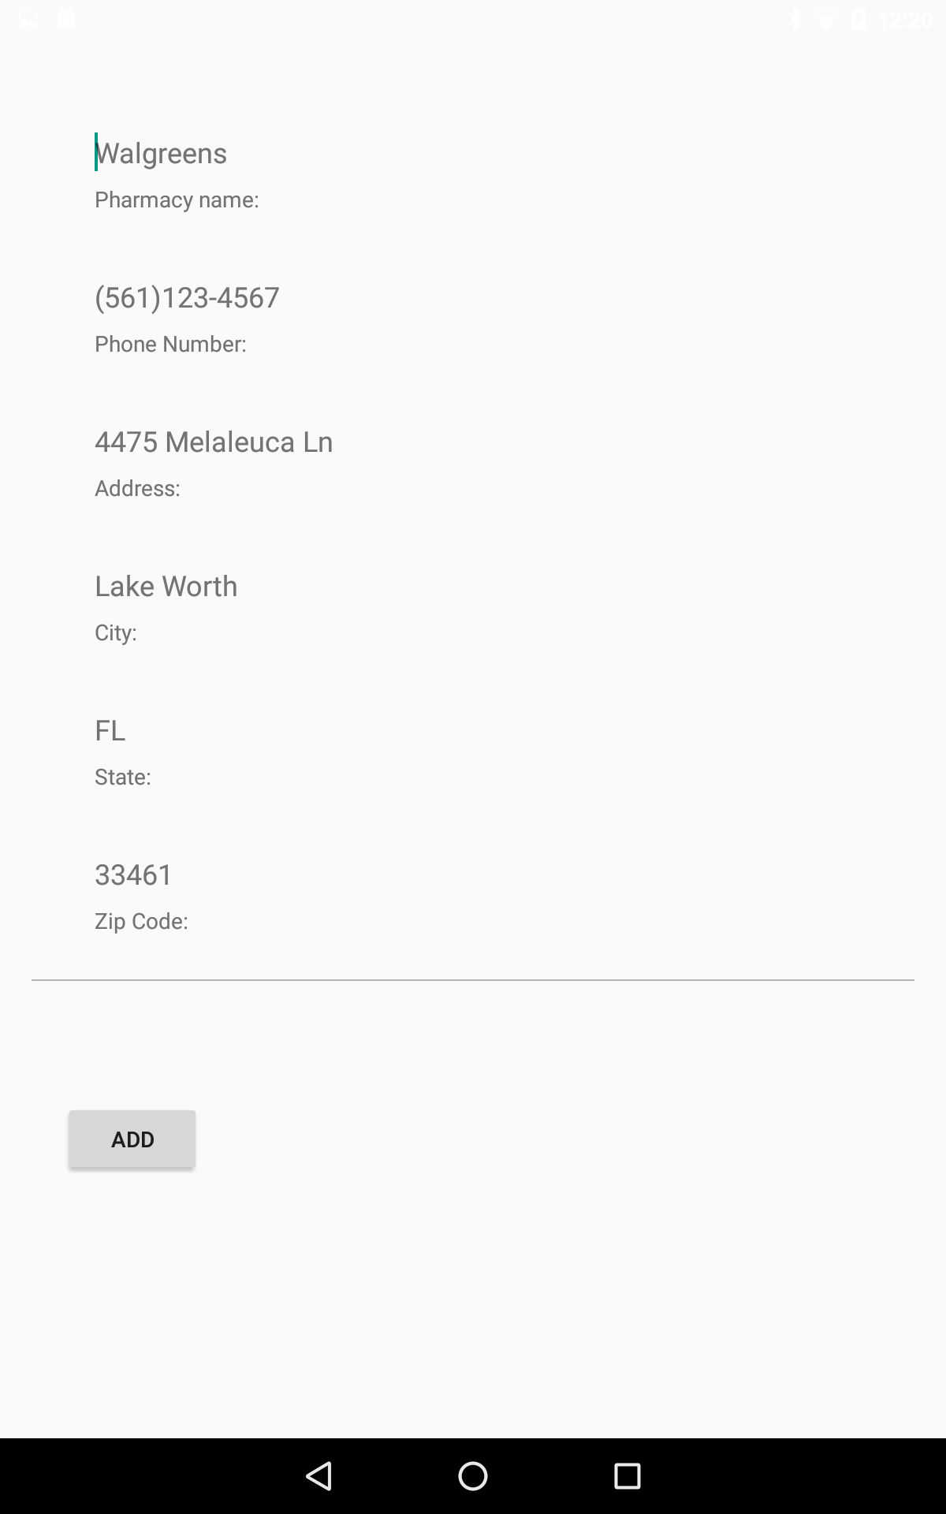
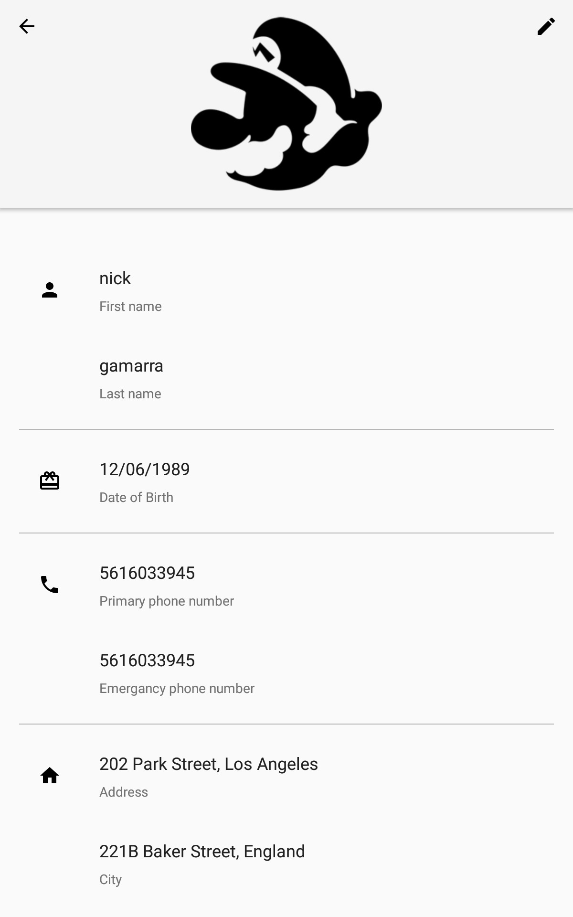
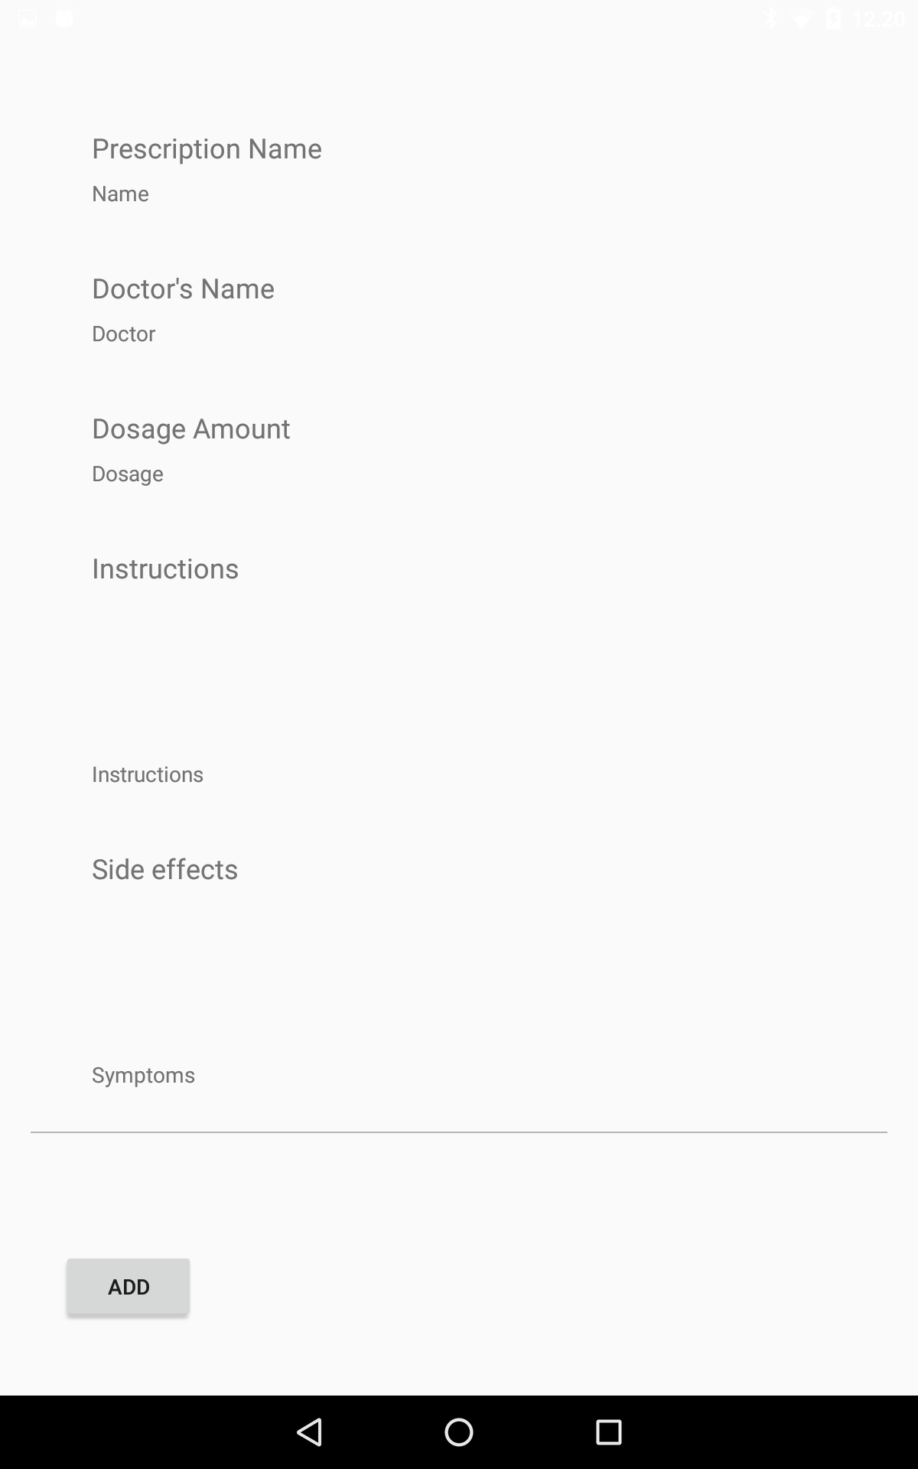
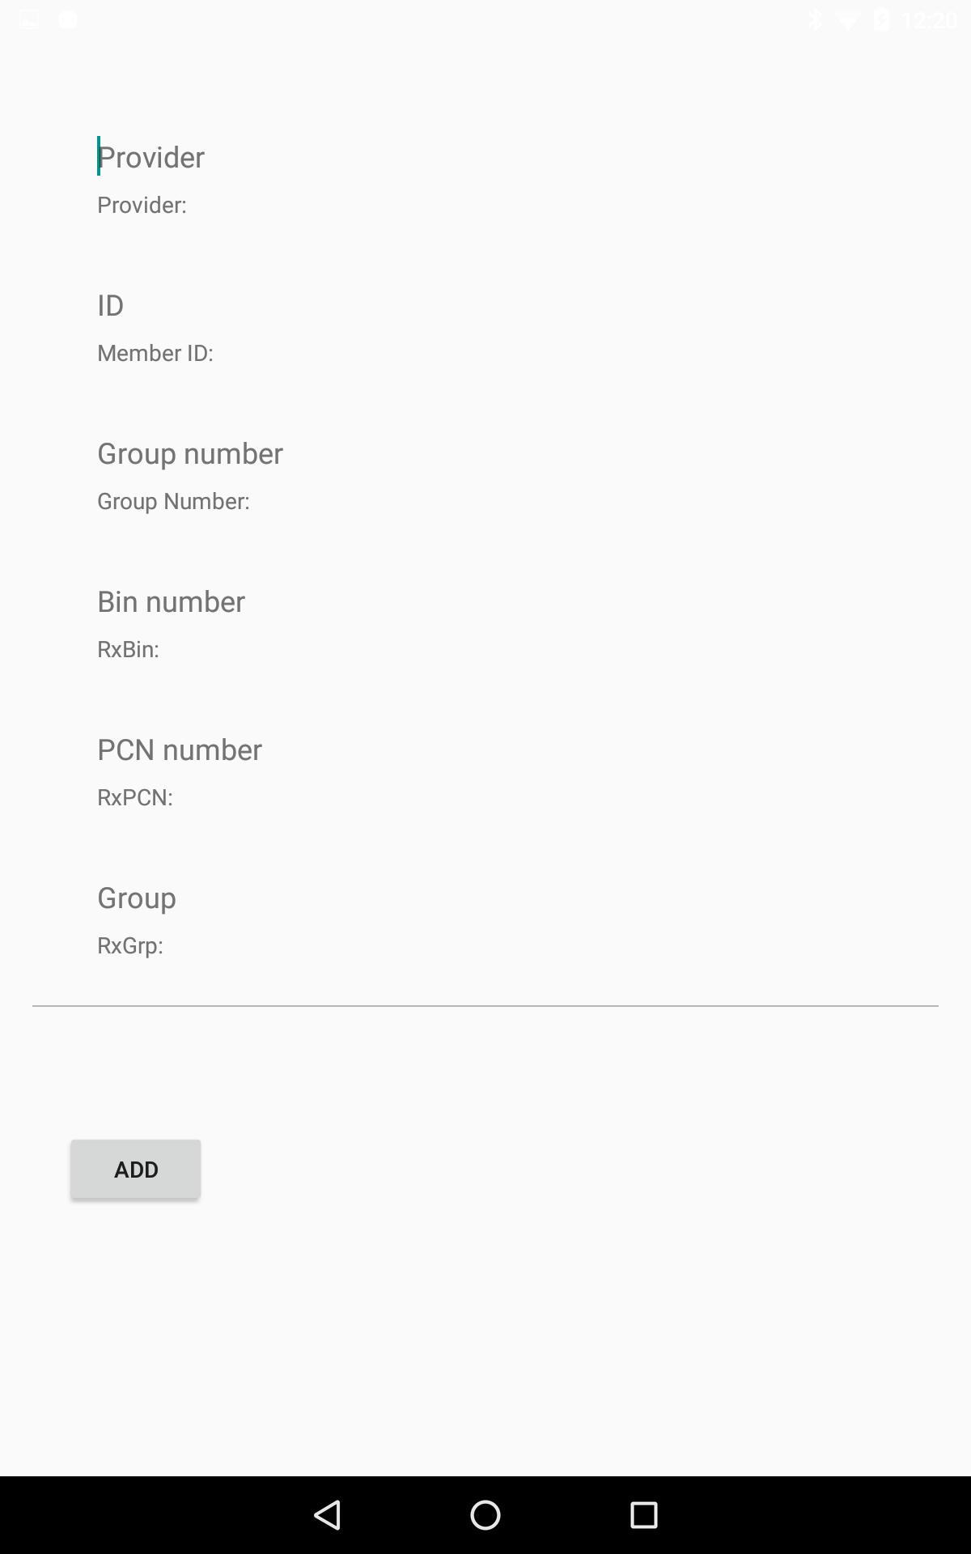
Edit/Add page
The layout for adding a category doubles as an edit layout as well.
The difference being that if the caregiver wants to edit something then the previous information will be pre loaded and the add the button will be turned into an add button
Also these are the categories that are only available to the caregiver and not the specialist. They can only view the information

Slide 10
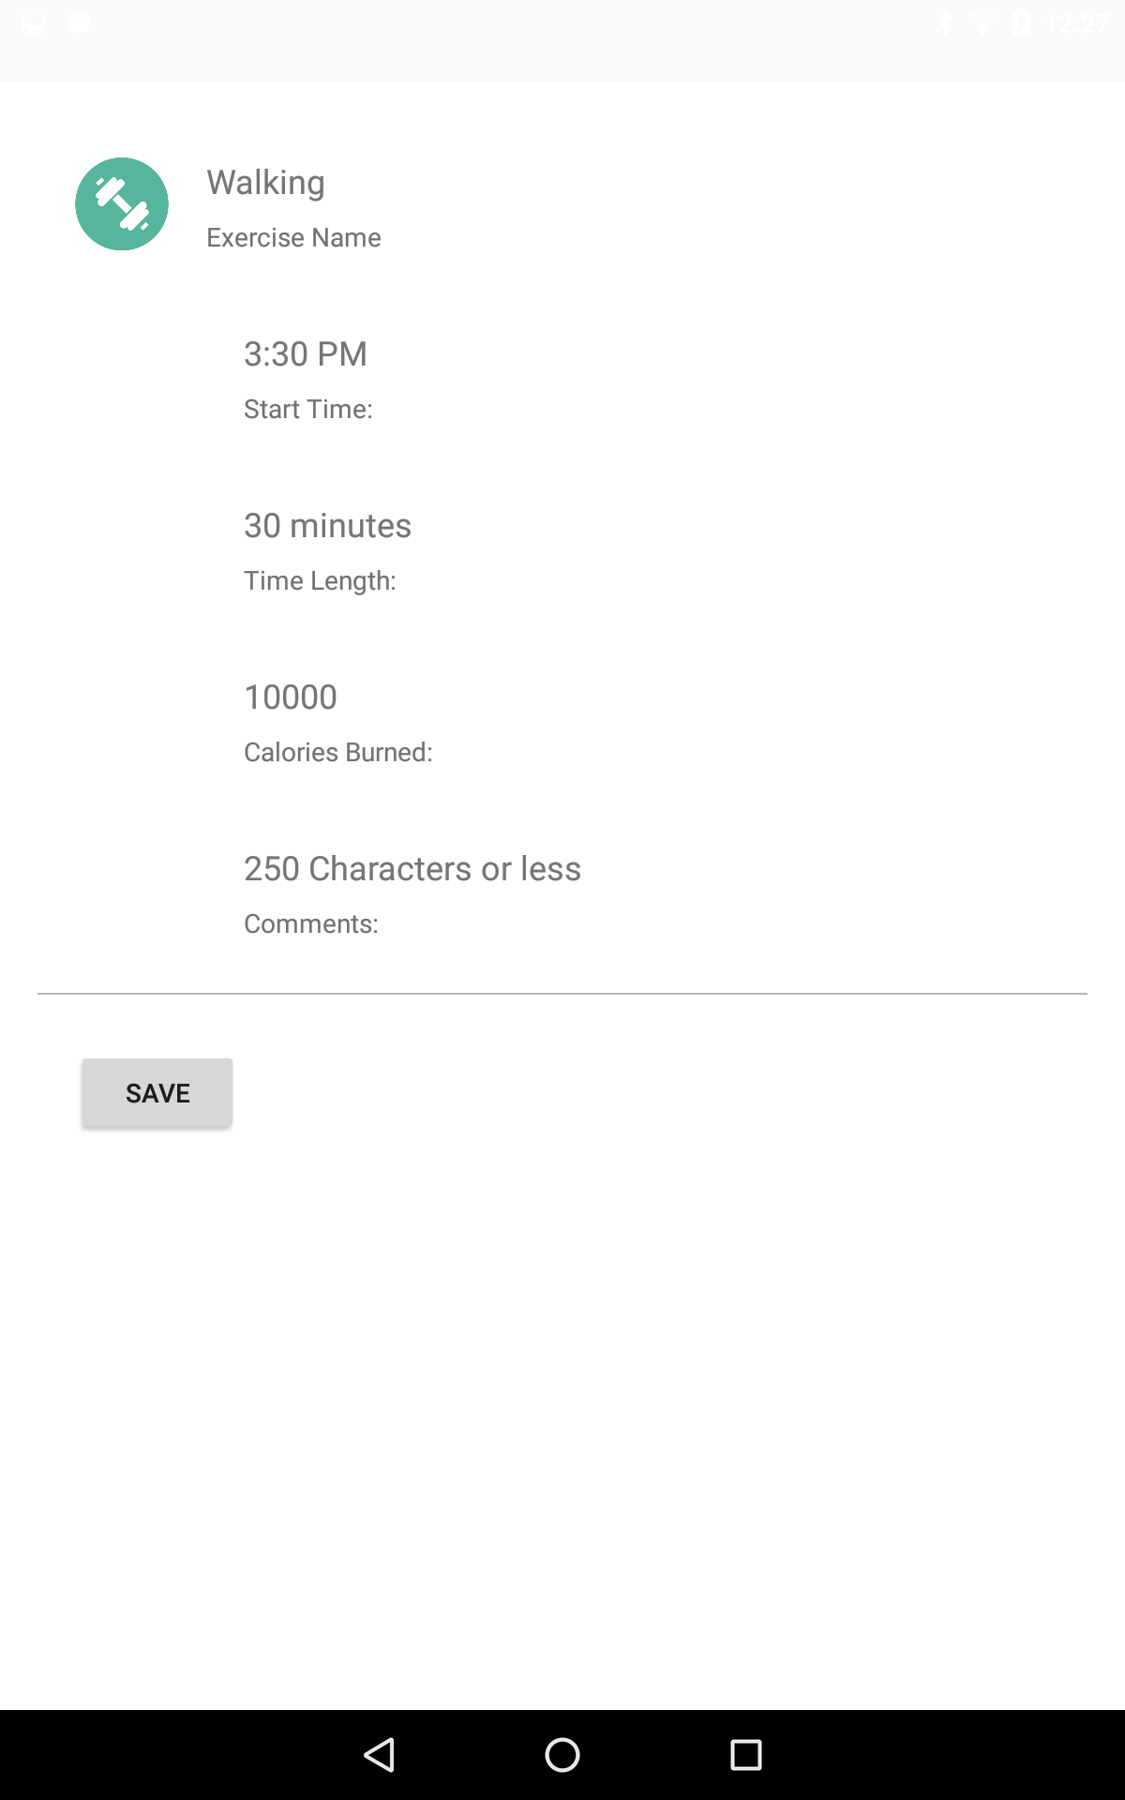
Specialist inputs
This is an example of what the specialist is allowed to add and not the caregiver
Exercises would be something the patients doctor asks the specialist to perform at home and so only the specialist would need to add in the exercises with the caregiver having access to them at any point once they were added in
Further developing
Specialist log
Nutritional meal plan

Slide 11
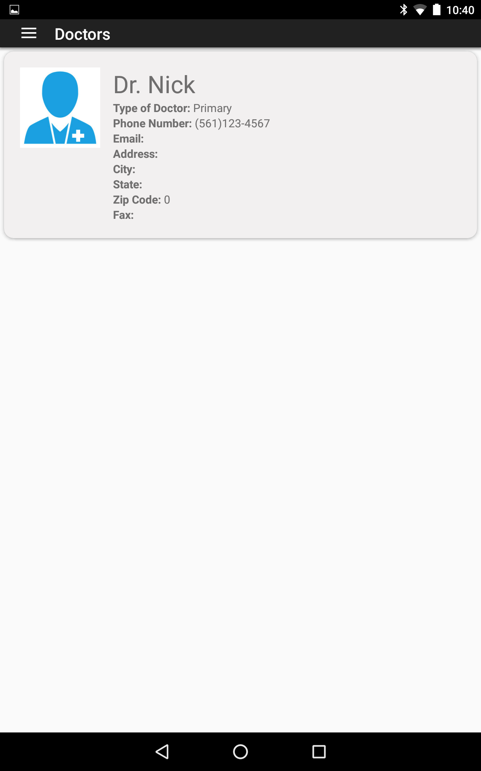
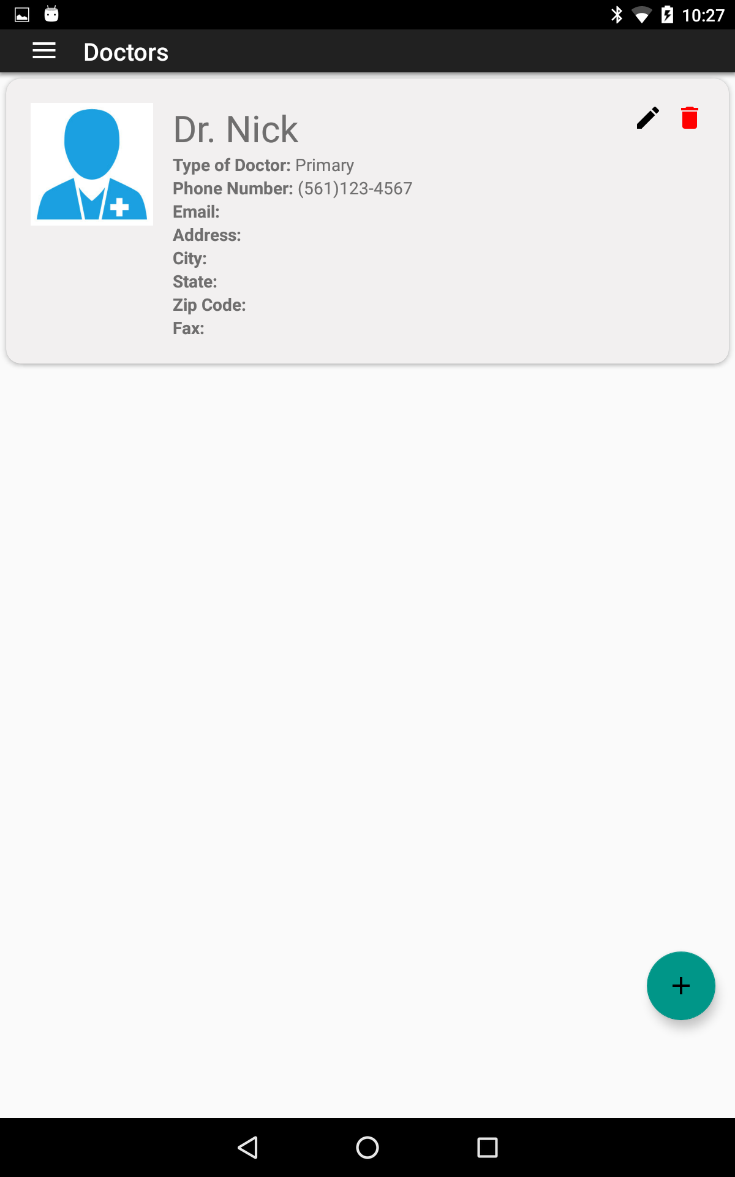
Here you see the difference in layouts based on the user that is logged in.
The caregiver(Right) has the capability to add, edit, and delete a doctor for the patient
While the specialist can only view the doctor

Slide 12
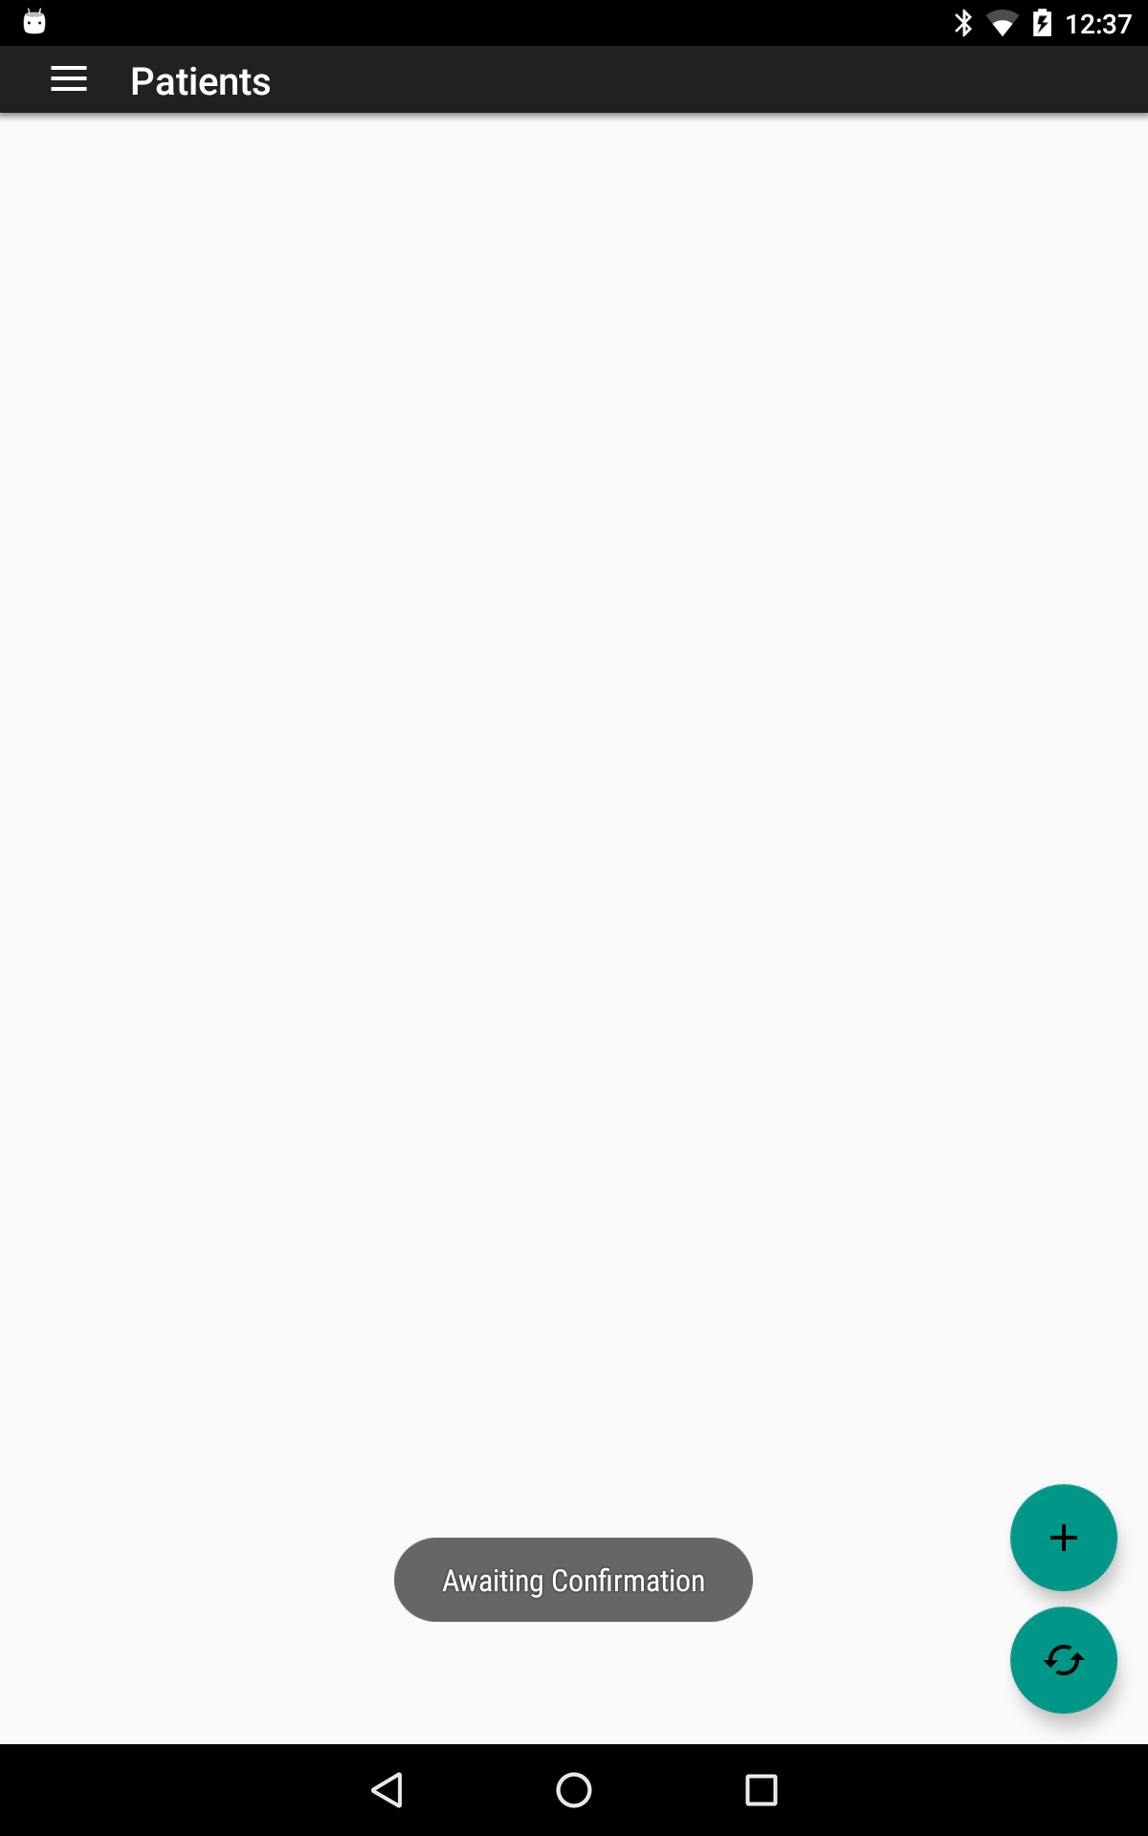
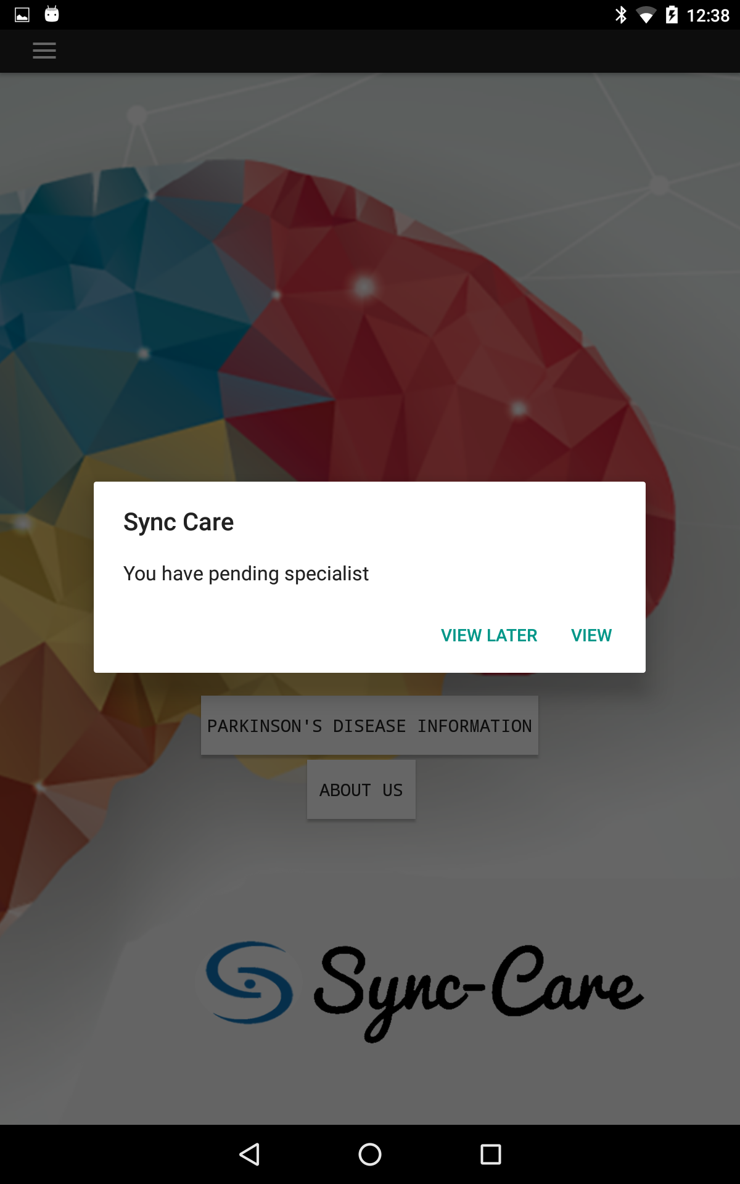
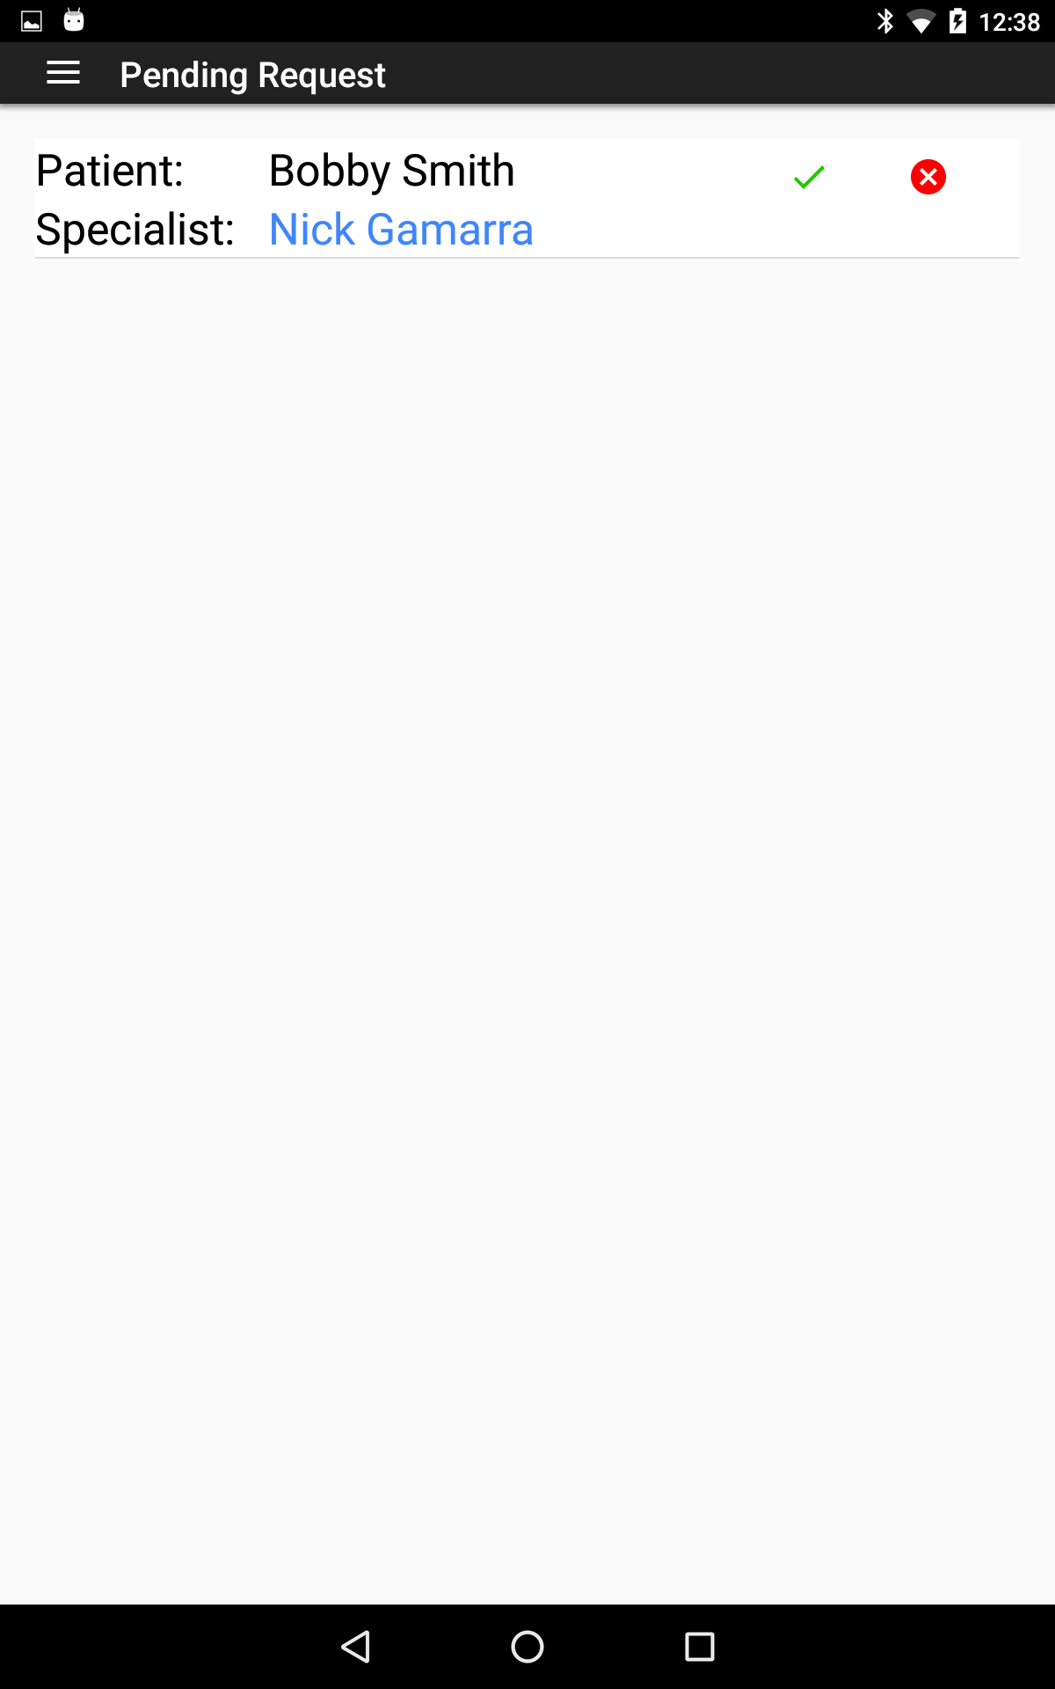
Managed Linked Patients
They can accept or decline the request.
The specialist can be clicked to get further information about them
At any point when the caregiver goes to their home screen, if they have pending requests they will be presented with a pop-up
Once the specialist enters the patients id they wait confirmation

Slide 13
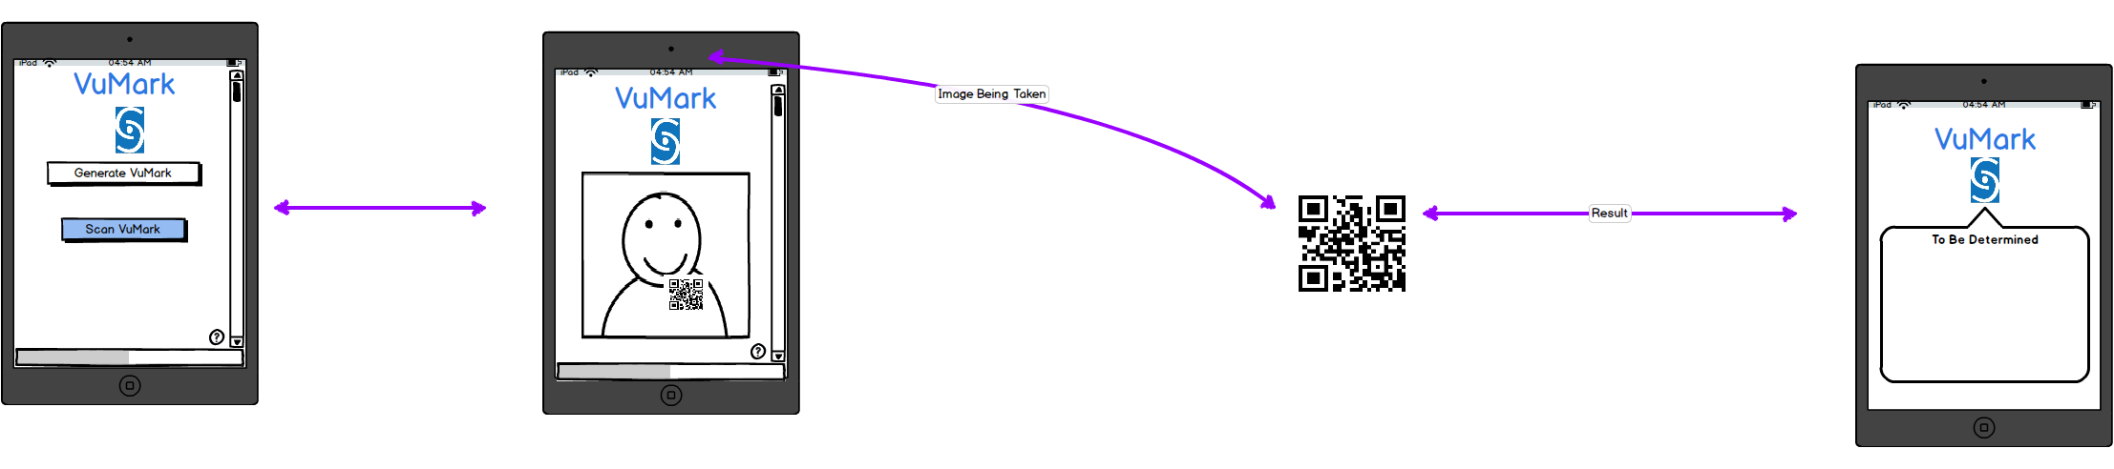
Augmented Reality
Each patient will be emailed a unique QR code that holds their ID Number. When scanned, you can:
Link to the patient upon approval
Display patient info
Scan prescription bottle with QR Code on it and view medication information

Slide 14
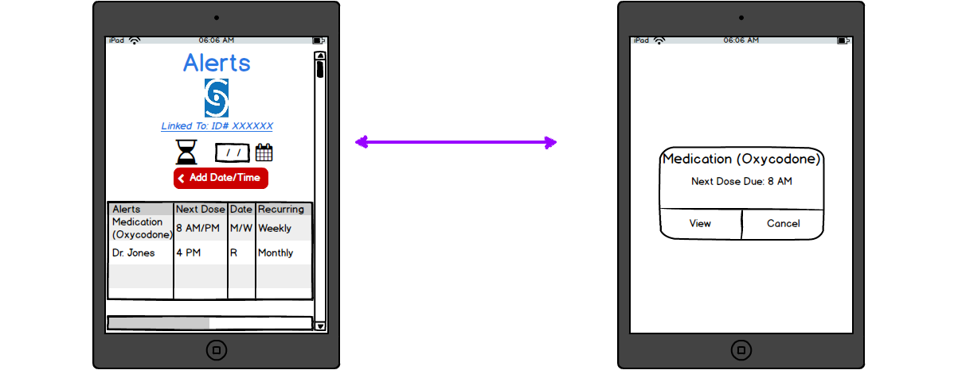
Alerts
The alerts will be able to be set any time for any specific request. Whether that is taking a certain medication, or remembering a doctors appointment, anything one deems applicable and necessary.

